Slide 1
Capstone: Find the best Locations in New York City for an African Cuisine/open an African Restaurant
Applied Data Science Capstone
IBM Data Science Professional Certificate
24th December, 2020
Author: Prince Osei

Slide 2
Introduction & Business Problem
This final project explores the best locations for African restaurants throughout the city of New York. Just with any business, opening a new restaurant requires a deliberate assessment of a lot of factors key among them is the location of the restaurant. The findings of this project will come in handy for African business men, investors, African governments, international African students and generally African immigrants. African governments who want to project African culture in the diaspora, and of course cuisine is a wonderful way to achieve that! This project will seek to answer the questions “Where should the investor open an African Restaurant?” and “Where should I go If I want a sumptuous African food?”

Slide 3
Data
New York City will be the object of this analysis, in order to find answers to the questions above. We need to segment the neighborhoods and explore them; we will essentially need a dataset that contains the 5 boroughs and the neighborhoods that exist in each borough as well as the latitude and longitude coordinates of each neighborhood. Data source: https://cocl.us/new_york_dataset
This data set contains the required information. And comes in very handy for our analysis. And we will use this data set to explore various neighborhoods of New York city. We wrangle the data, clean it, and then read it into a pandas dataframe so that it is in a structured format.
FourSquare API:
Location coordinates of different neighborhoods will be returned using Foursquare API. Finding popular venues in different neighborhoods from FourSquare API. I will use the FourSquare API to explore different neighborhoods in New York City. The Foursquare explore function will be used to get the most popular venues in each neighborhood in terms of African restaurants. All data related to locations and quality of African restaurants will be obtained via the FourSquare API utilized via the Request library in Python. And the best viable locations for establishing an African restaurant.

Slide 4
Methodology
Data will be collected from https://cocl.us/new_york_dataset
dataset and cleaned and processed into a dataframe. This is to allow us to handle the data set structurally and computationally.
FourSquare be used to locate all venues and then filtered by African restaurants. Ratings, tips, and likes by users will be counted and added to the dataframe. Gives us the best locations and potential markets for African restaurants.
Data will be sorted based on rankings to bring the hidden juicy locations or places of interest.
Finally, the data be will be visually assessed using graphing from Python libraries by employing folium.

Slide 5
Results
The results of the analysis revealed the following key insights:
The borough of Queens which is the largest borough in New York City has the highest number of neighborhoods in New York City.
This exercise revealed that the Borough of Manhattan has the least number of Neighborhoods in New York, thus about 40 neighborhoods as compared to the other boroughs Bronx, Brooklyn, Queens and Staten Island.
We see that the Boroughs Bronx and Manhattan have the highest number of African restaurants in New York City each pegged at five African Restaurants.
We found out that the neighborhood of Central Harlem in the Borough of Manhattan has the highest number of African Restaurants (Three in number)
East Harlem (8.8) is the best neighborhood in terms of restaurant ratings for African restaurants, followed by Crown Heights (8.5).
We also found out the highest borough for African restaurants in New York in Manhattan. Thus, Manhattan is the highest rated borough in New York as far as African restaurants are concerned.
The highest rated Restaurant is Teranga restaurant in East Harlem

Slide 6
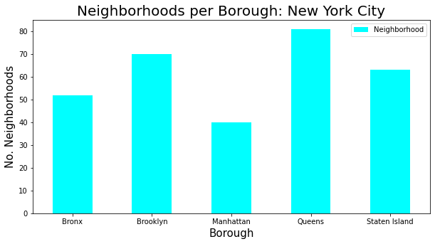
Results
The borough of Queens which is the largest borough in New York City has the highest number of neighborhoods in New York City. Manhattan has the least number of neighborhoods.

Slide 7
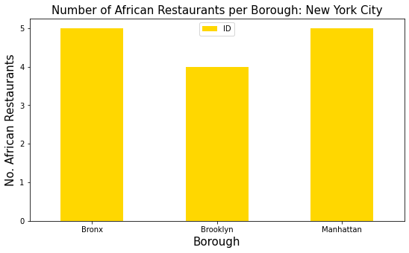
Result
The Boroughs Bronx and Manhattan have the highest number of African restaurants in New York City.

Slide 8
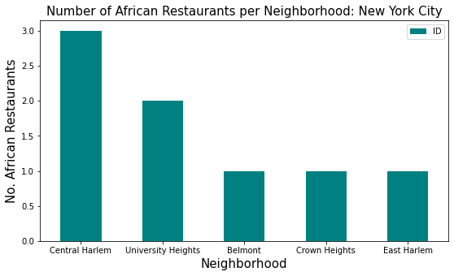
Results
Central Harlem in the Borough of Manhattan has the highest number of African Restaurants in New York City.

Slide 9
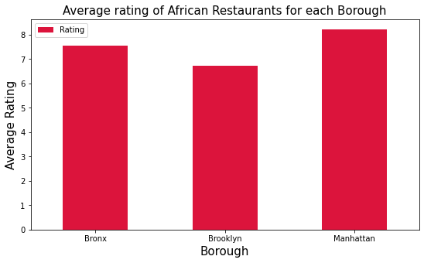
Results
Manhattan is the highest rated borough in New York as far as African restaurants are concerned.

Slide 10
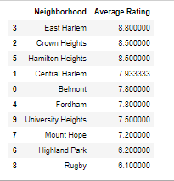
Results
The neighborhood of East Harlem is the highest rated in New York as far as African restaurants are concerned.

Slide 11
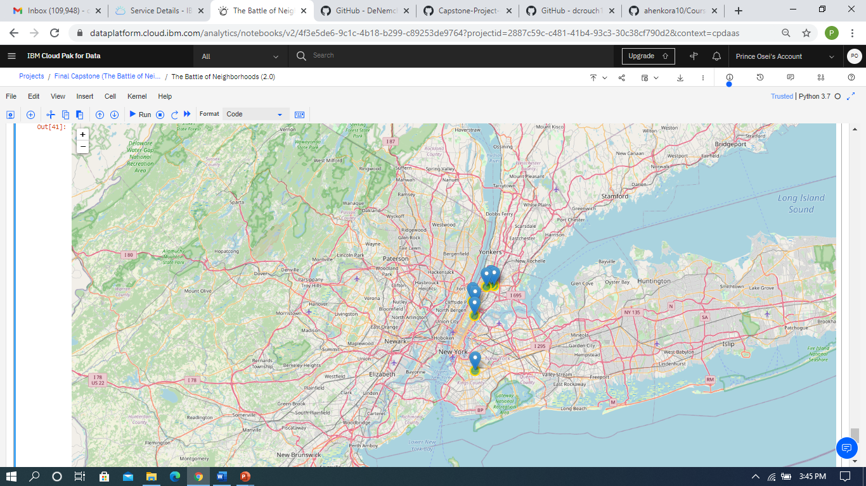
Results(Pictorial View)
Map of New York City Showing the top rated seven neighborhoods and points of African Restaurants.
Fordham, Bronx(7.8)
Belmont, Bronx(7.8
Hamilton Heights, Manhattan(8.5)
Central Harlem, Manhattan(7.933)
East Harlem, Manhattan(8.8)
University Heights, Bronx(7.5)
Crown Height, Brooklyn(8.5)

Slide 12
Discussion
From the results of our general and exploratory analysis, I can categorically state that Manhattan is the best location or borough to find some wonderful African cuisine in New York City. Manhattan is the largest and most densely populated borough in the whole of New York City. Manhattan has the least number of neighborhoods in the whole of New York City. This may have accounted for its high rating in terms of the best place for African cuisine. Specifically, we can zero in on the neighborhood of East Harlem as the best neighborhood one can go for a lovely African cuisine. Teranga restaurant is the best restaurant one can go and enjoy a lovely African dish. According to the United States Census Bureau, the borough of Bronx has an appreciable population of Africans/black or African Americans. A big market or high demand for a business such as a restaurant is critical to the survival and growth. Of course, a restaurant situated at a place or location where an appreciable number of people long for foodies of such a restaurant is plus. Bronx again has multiple neighborhoods with high ratings exceeding 7.5(scale 1.0 – 10.0). The Bronx is home to a growing population of African immigrants, many of whom have arrived within the last ten years, between 2007 and 2014, the number of West African immigrants in the borough increased by more than 60 percent, according to census data collected by Queens College. Again, Bronx is also known for a great place for outdoor activities in New York City. The borough of Bronx is the cheapest borough to live in and The Bronx is 41.4% less expensive than Manhattan. The Bronx housing costs are 65.0% less expensive than Manhattan housing costs. This place is attractive to African immigrants as result of its large community of people of African descent. I would finally recommend a place in the Bronx specifically neighborhoods of Fordham, University Heights or Belmont as all of these places have very high ratings in terms of African restaurants in the Bronx. Again, another good recommendation would be in East Harlem of Manhattan or Crown Heights of Brooklyn. As Brooklyn has a considerable African resident in New York City and cheaper prices of properties compared to Manhattan.

Slide 13
Conclusion
In this project we have chronologically gone through coming up with a business problem and specifying the data required, extracting and preparing the data, leveraging on exploratory data analysis, giving investors/stakeholders recommendations. These finds will help the respective stakeholders have some tips as to the merits and demerits of opening an African cuisine in a particular location. Again, helping stakeholders find the best places they could enjoy some wonderful African Cuisine in Neighborhoods and boroughs of New York City.

Slide 14
THANK YOU

